Slide 1
SALES PREDICTOR FOR
SUPERMARKET
By-
Perumalla Dharan - AP21110010201
Pavan Sastry NVSS - AP21110010209
Phalgun Vatala - AP21110010223
Grandhi Dinesh - AP21110010240
Gurram V S Rehan - AP21110010259

Slide 2
TABLE OF CONTENTS
Abstract
Motivation
Goal
Methodology in detail
Result/outcome

Slide 3
Abstract
This project revolves around building a predictive model for Supermarket using sales data collected in 2013.
Retail businesses need to predict and improve their sales to do well. In this project, we're looking at sales data from Supermarket. They have data about 1559 products in 10 stores in different cities.
The goal is to predict the sales of each product in a particular store, which will enable Supermarket to understand the factors influencing sales and optimize their strategies accordingly.
Supermarket wants to use this model to figure out what things about products and stores help sales the most. This will help them make better plans to make more money.

Slide 4
Motivation
The retail sector faces increasing pressure to adapt to changing consumer behaviors and market dynamics. Previous studies have demonstrated the efficacy of predictive modeling in driving business outcomes such as inventory optimization, demand forecasting, and personalized marketing.
By harnessing the power of machine learning and analytics, companies like Super Markets can unlock hidden insights within their data, enabling more informed decision-making and strategic planning.
This project aims to help Super Market by using data analysis to provide useful information. This can help the company stay competitive.

Slide 5
Goal
Our primary goal of this project is to develop a predictive model that accurately forecasts the sales of each product in the Supermarket By addressing the following key objectives, our aim to provide actionable insights to Supermarket management team:
Utilize machine learning techniques to analyze the relationship between various product and store attributes and sales.
Identify the most significant factors influencing sales and their impact on product performance.
Provide actionable insights to Supermarket to optimize product placement, pricing strategies, and inventory management.

Slide 6
Methodology in Detail
About Data Set
Data Preprocessing
Exploratory Data Analysis(EDA)
Model Selection and Training

Slide 7
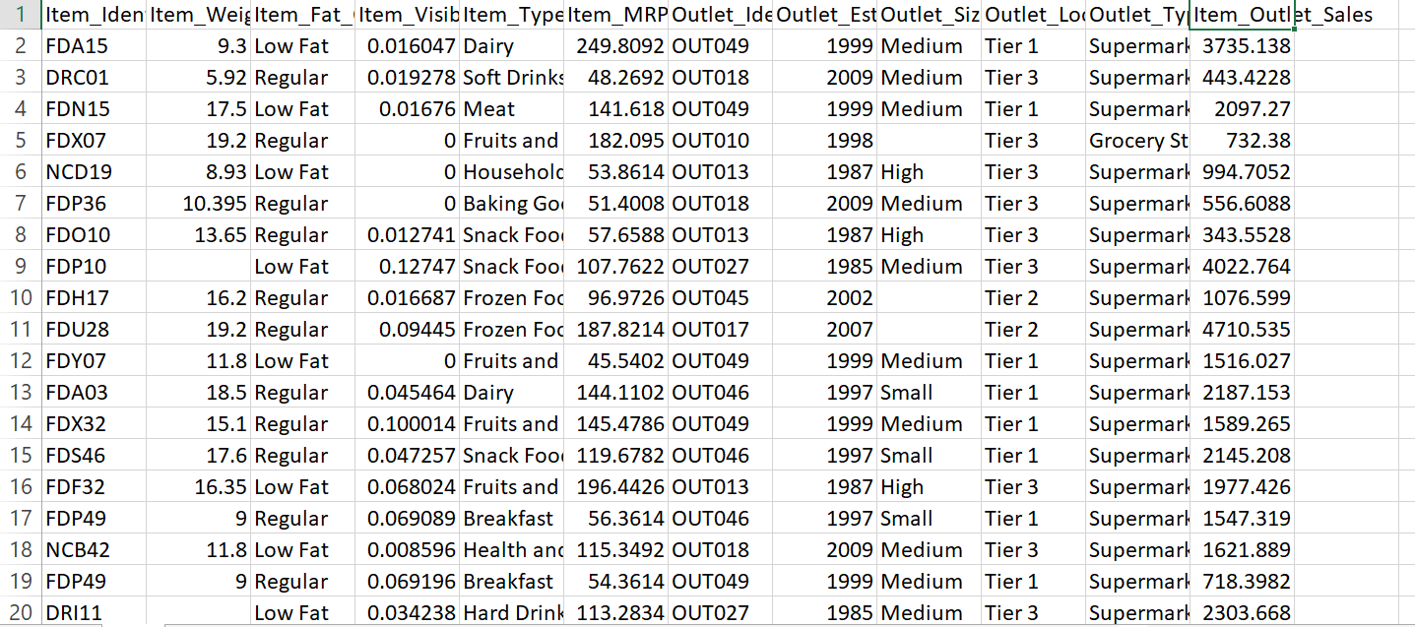
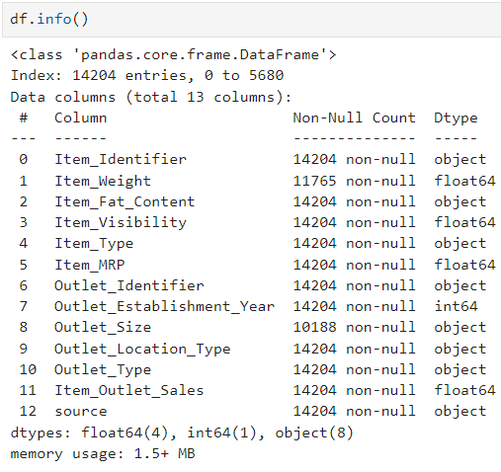
About Data Set
Our dataset contains 12 features and data for 1559 products across 10 stores in different cities
Total data contains in dataset is 14204

Slide 8
Data Preprocessing
Handling missing values in the dataset : Identifying and addressing any missing values in the dataset, which may arise due to data entry errors, technical issues, or incomplete records. Common techniques for handling missing values include imputation (replacing missing values with estimates such as mean, median, or mode), deletion (removing rows or columns with missing values), or advanced imputation methods based on the relationships between variables.
Dealing with Outliers : Detecting and addressing outliers, which are data points that significantly deviate from the rest of the dataset. Outliers can distort statistical analyses and machine learning models, leading to inaccurate results.
Correcting Data Types : Ensuring that variables are encoded with the appropriate data types (e.g., numeric, categorical, datetime) to facilitate analysis and modeling. This may involve converting categorical variables to dummy variables (one-hot encoding), parsing datetime variables, or converting numerical variables to the desired format.
cleaning the dataset like identifying and rectifying any inconsistencies and errors , removing duplicates,
addressing inconsistent data such as conflicting information across variables or logical errors
standardizing the dataset to prepare it for analysis.

Slide 9
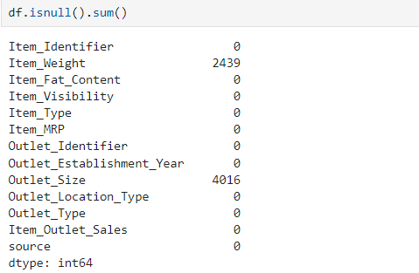
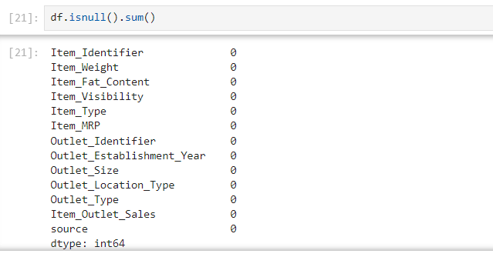
Handling Null Values

Slide 10
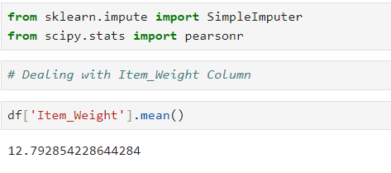
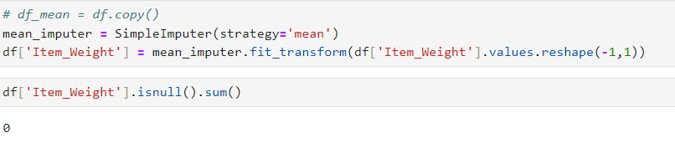
Dealing with Missing Values
mean for item_weight

Slide 11
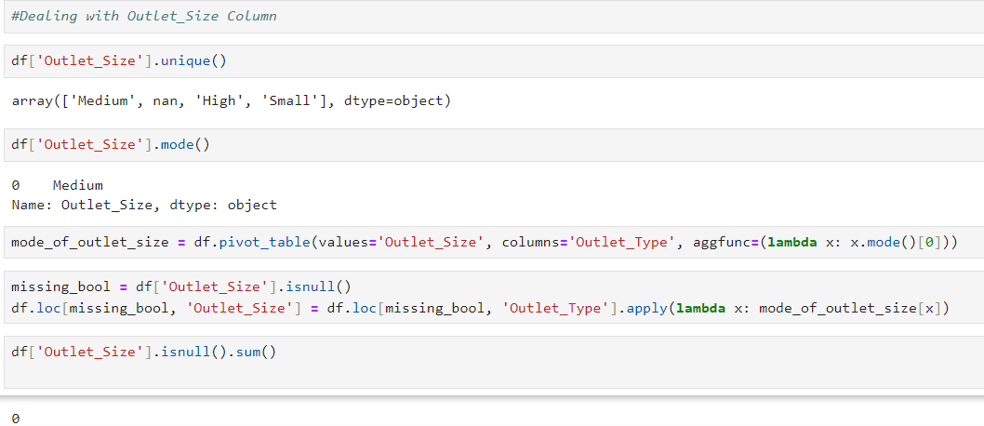
Dealing with Missing Values

Slide 12
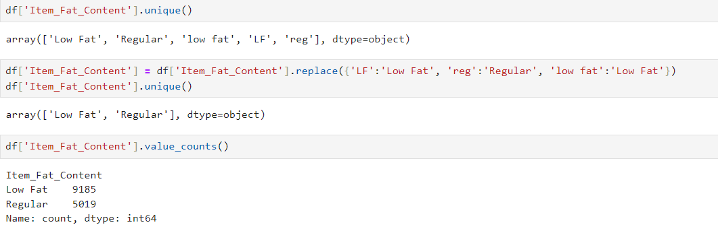
Dealing With Irregular Data

Slide 13
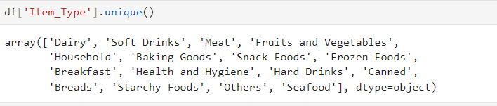
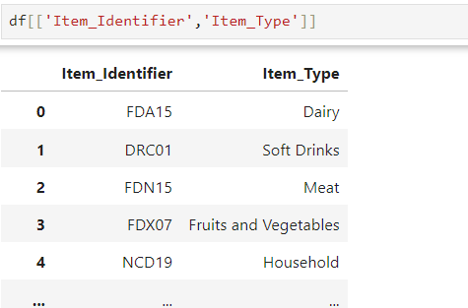
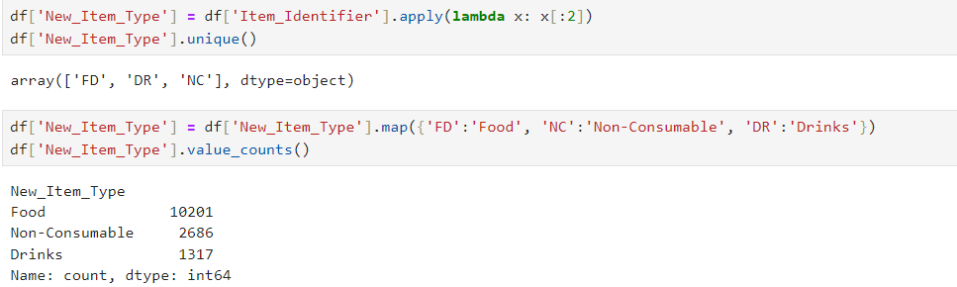
Data Preprocessing

Slide 14
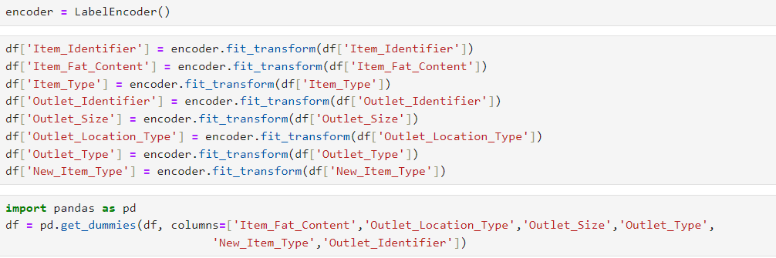
One-Hot encoding
One-hot encoding is a technique used in machine learning and data preprocessing to handle categorical variables, transforming them into a format that can be provided to machine learning algorithms.

Slide 15
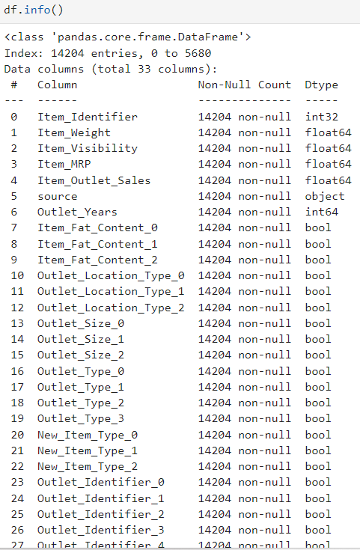
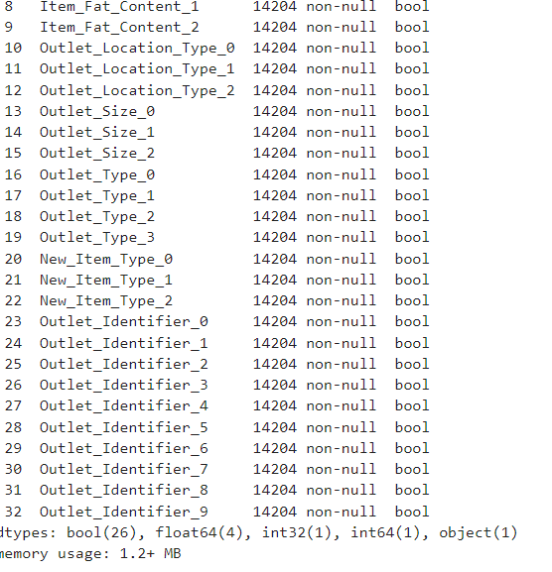
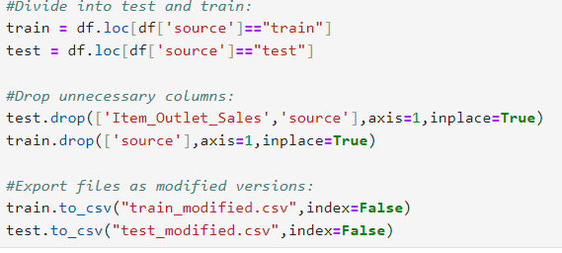
Pre processing

Slide 16
Exploratory Data Analysis(EDA)
Data Visualization:
We used Seaborn and Matplotlib to visualize various aspects of the dataset, such as the distribution of 'Item_Weight', 'Item_Visibility', 'Item_MRP', and 'Item_Outlet_Sales'.
Count plots were utilized to visualize the distribution of categorical variables like 'Item_Fat_Content', 'Item_Type', 'Outlet_Establishment_Year', 'Outlet_Size', 'Outlet_Type', and 'Outlet_Location_Type'.
The sns.displot function was used to create KDE plots for continuous variables.
Exploring Missing Values:
We checked for missing values in the dataset using df.isnull().sum() and visualized them using the msno.matrix() function from the missingno library.
Feature Engineering:
New features such as 'New_Item_Type' and 'Outlet_Years' were created based on existing columns, which is a part of EDA to derive meaningful insights from the data.

Slide 17
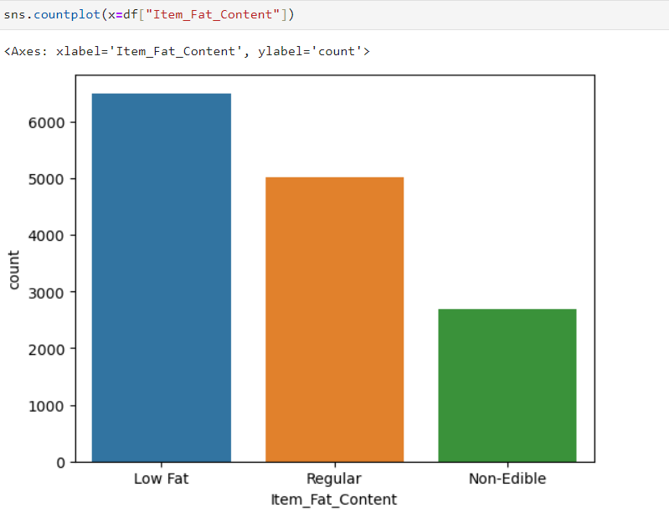
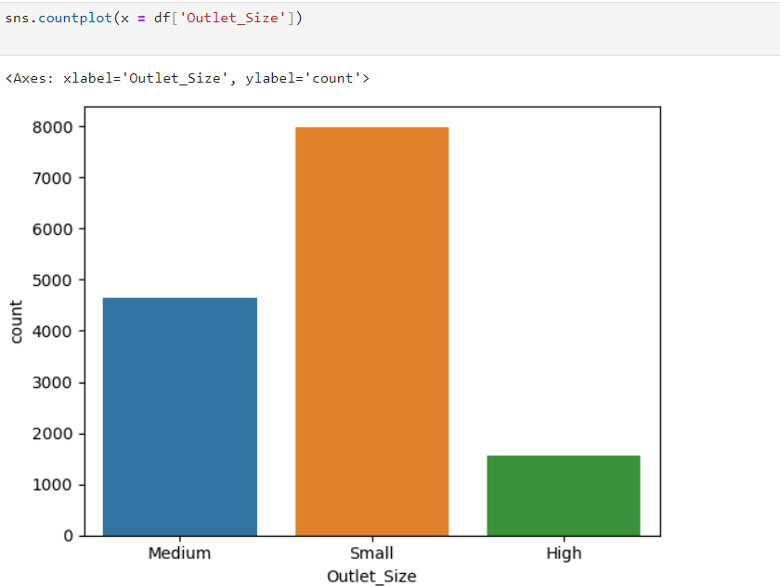
Visualizing Insights

Slide 18
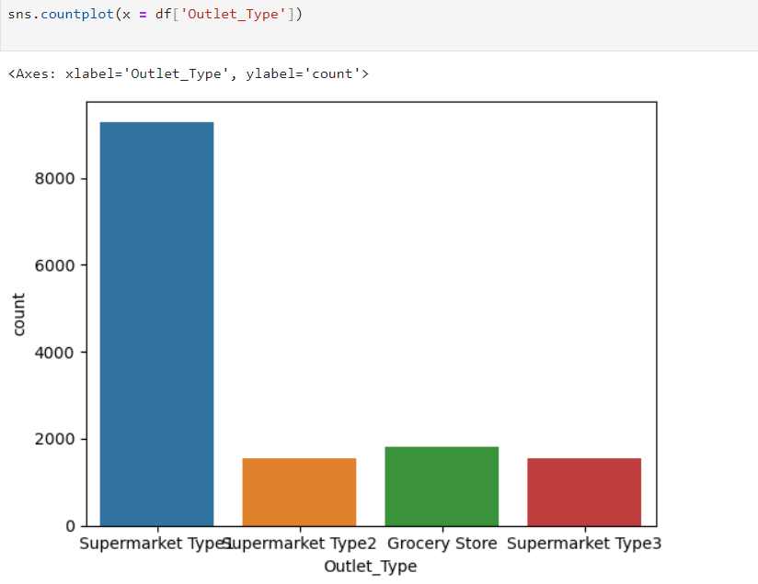
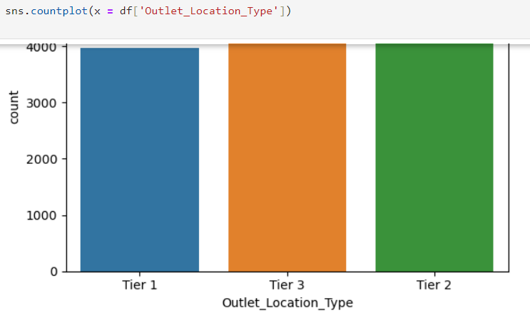
Visualizing Insights

Slide 19
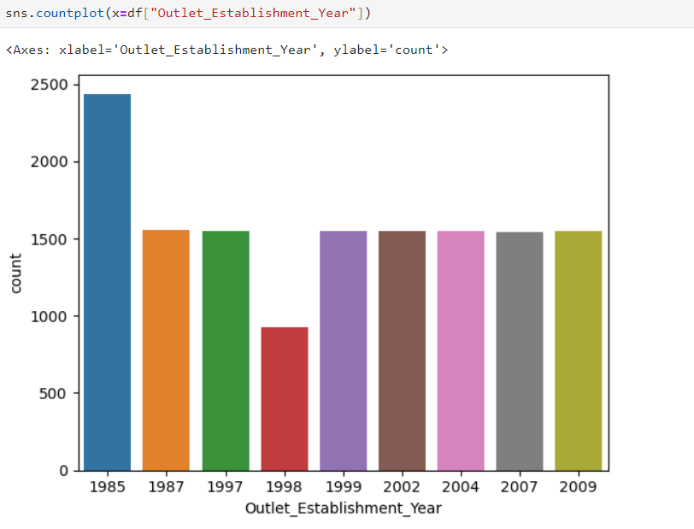
Visualizing Insights

Slide 20
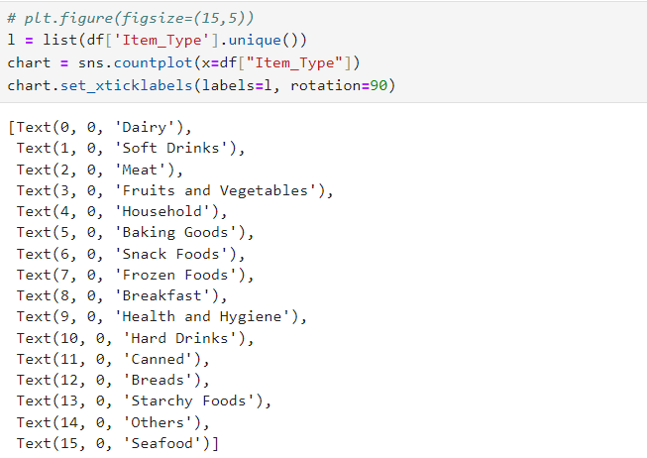
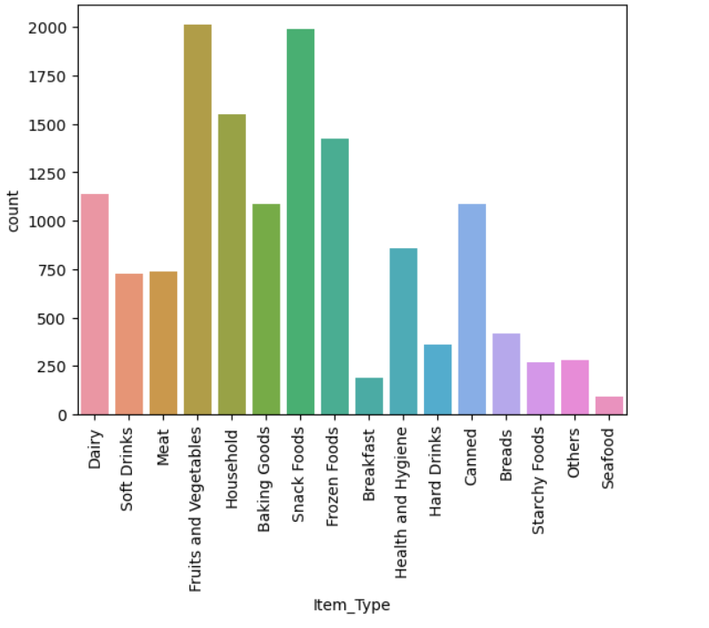
Visualizing Insights

Slide 21
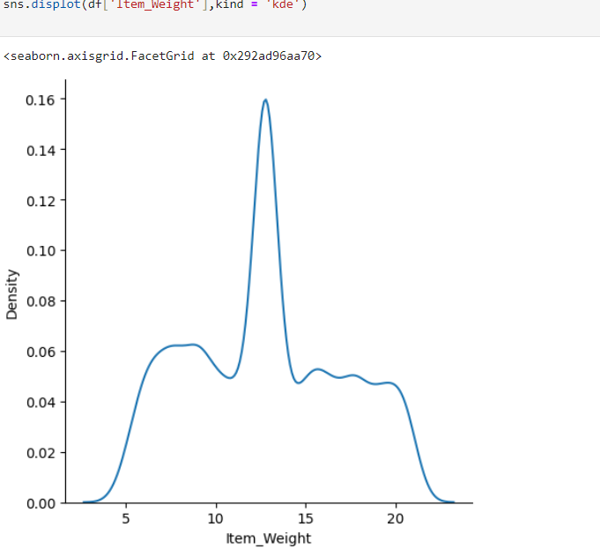
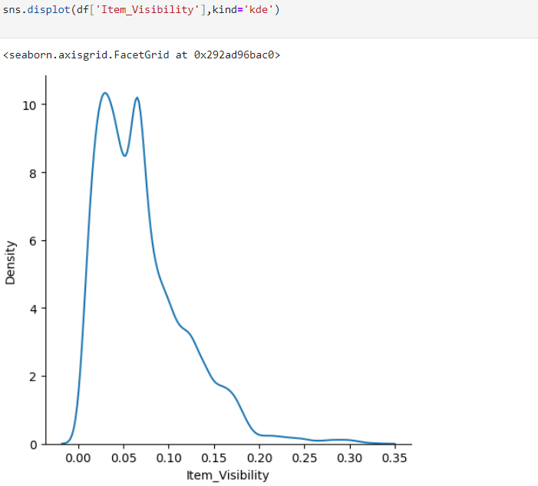
Seaborn

Slide 22

Count Plot

Slide 23
Model selection and training
We imported various regression algorithms from scikit-learn, including Linear Regression, Ridge Regression, Lasso Regression, Decision Tree Regression, Random Forest Regression, and XGBoost Regression.
For each algorithm, we created an instance of the algorithm and called the modelfit function to train the model, evaluate its performance on the training set, and make predictions on the test set.

Slide 24
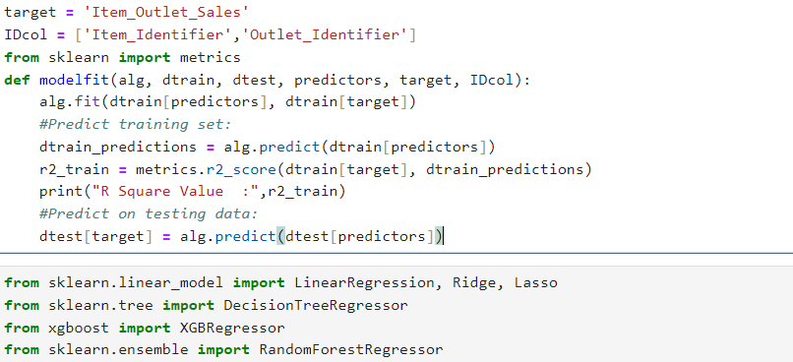
Model selection and training

Slide 25
Implementation Results of regression models:
After Selecting models we implemented the models and their outputs are displayed in the next slides.
Linear Regression
Ridge
Lasso
Decision tree
XGB Regressor
Random Forest

Slide 26
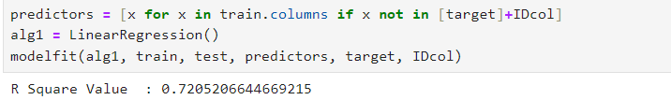
Linear regression OUTPUT

Slide 27

Ridge OUTPUT

Slide 28

Lasso OUTPUT

Slide 29

Decision Tree OUTPUT

Slide 30

Random Forest OUTPUT

Slide 31

XGB Regressor OUTPUT

Slide 32
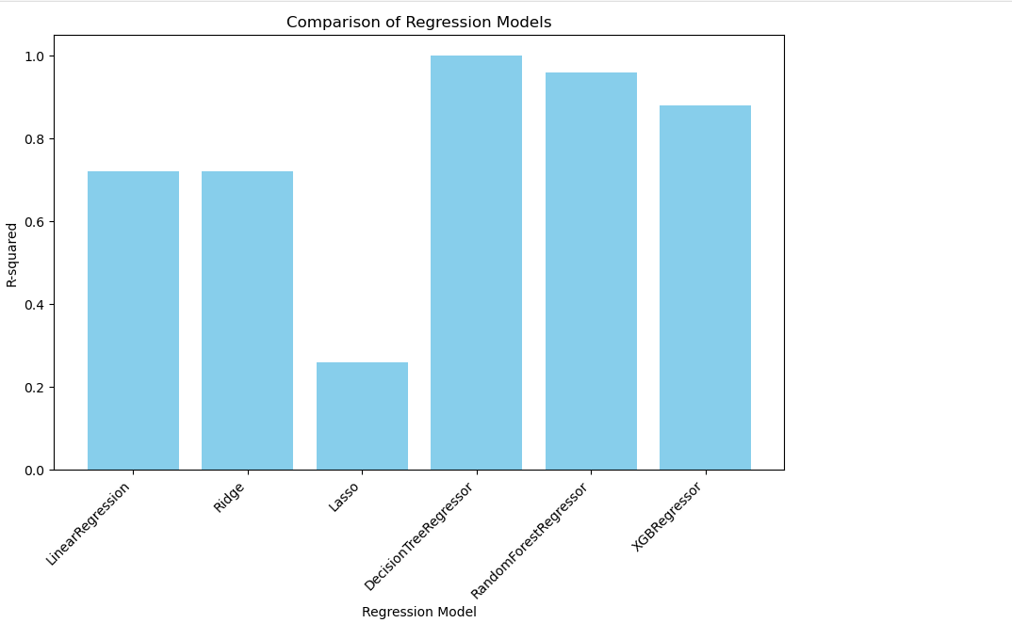
Result/Outcome
By implementing all regression models we came to know to know that decision tree performed well.

